Slide 1
Kopsali Harris
TechPro Academy
Stream: Front-end
Tasks From 1st Lesson.
Deadline: 19/10/2023

Slide 2

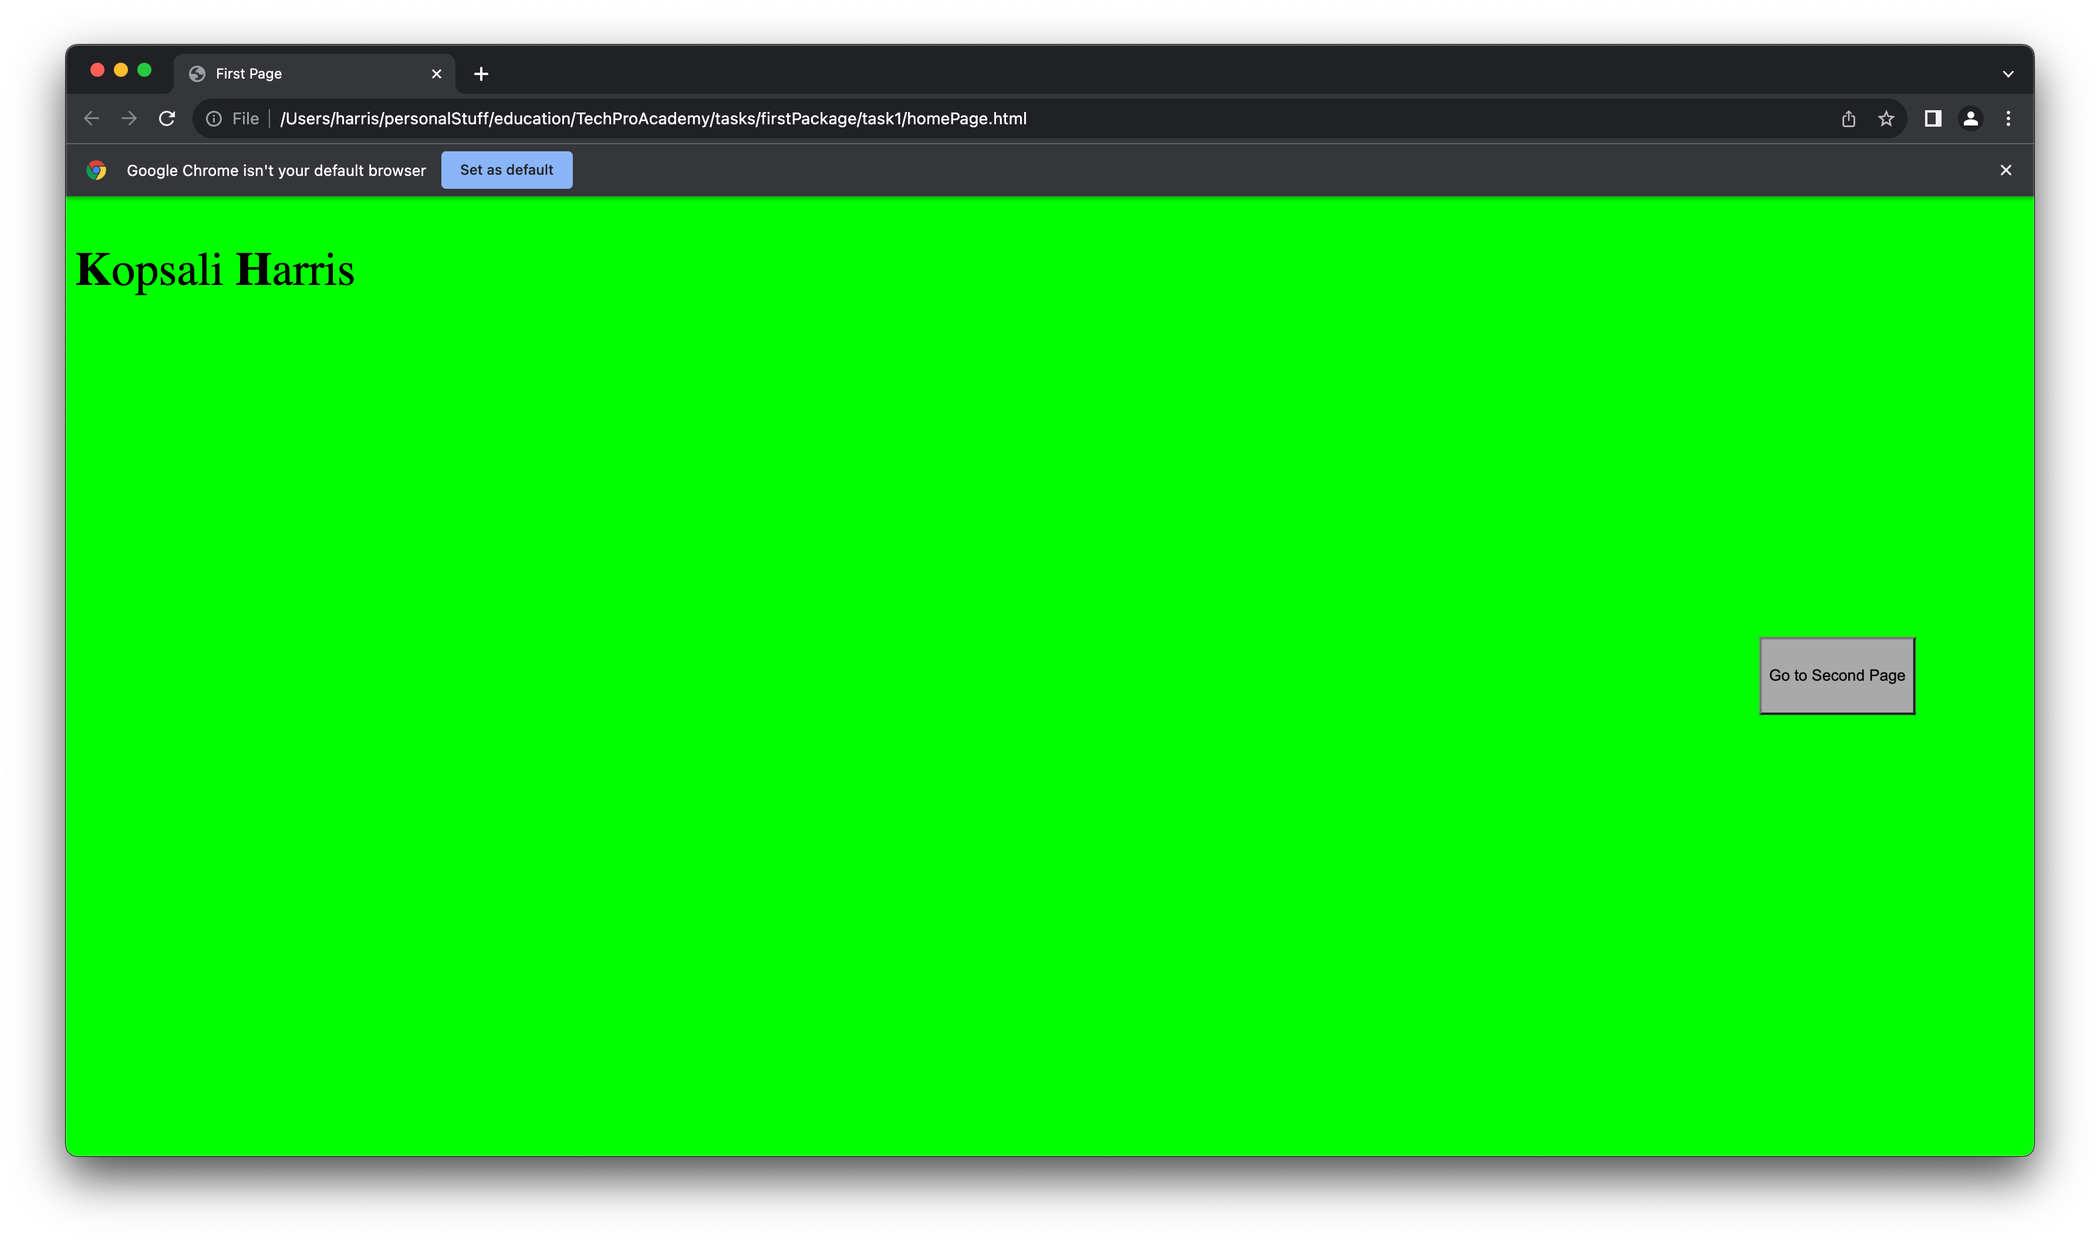
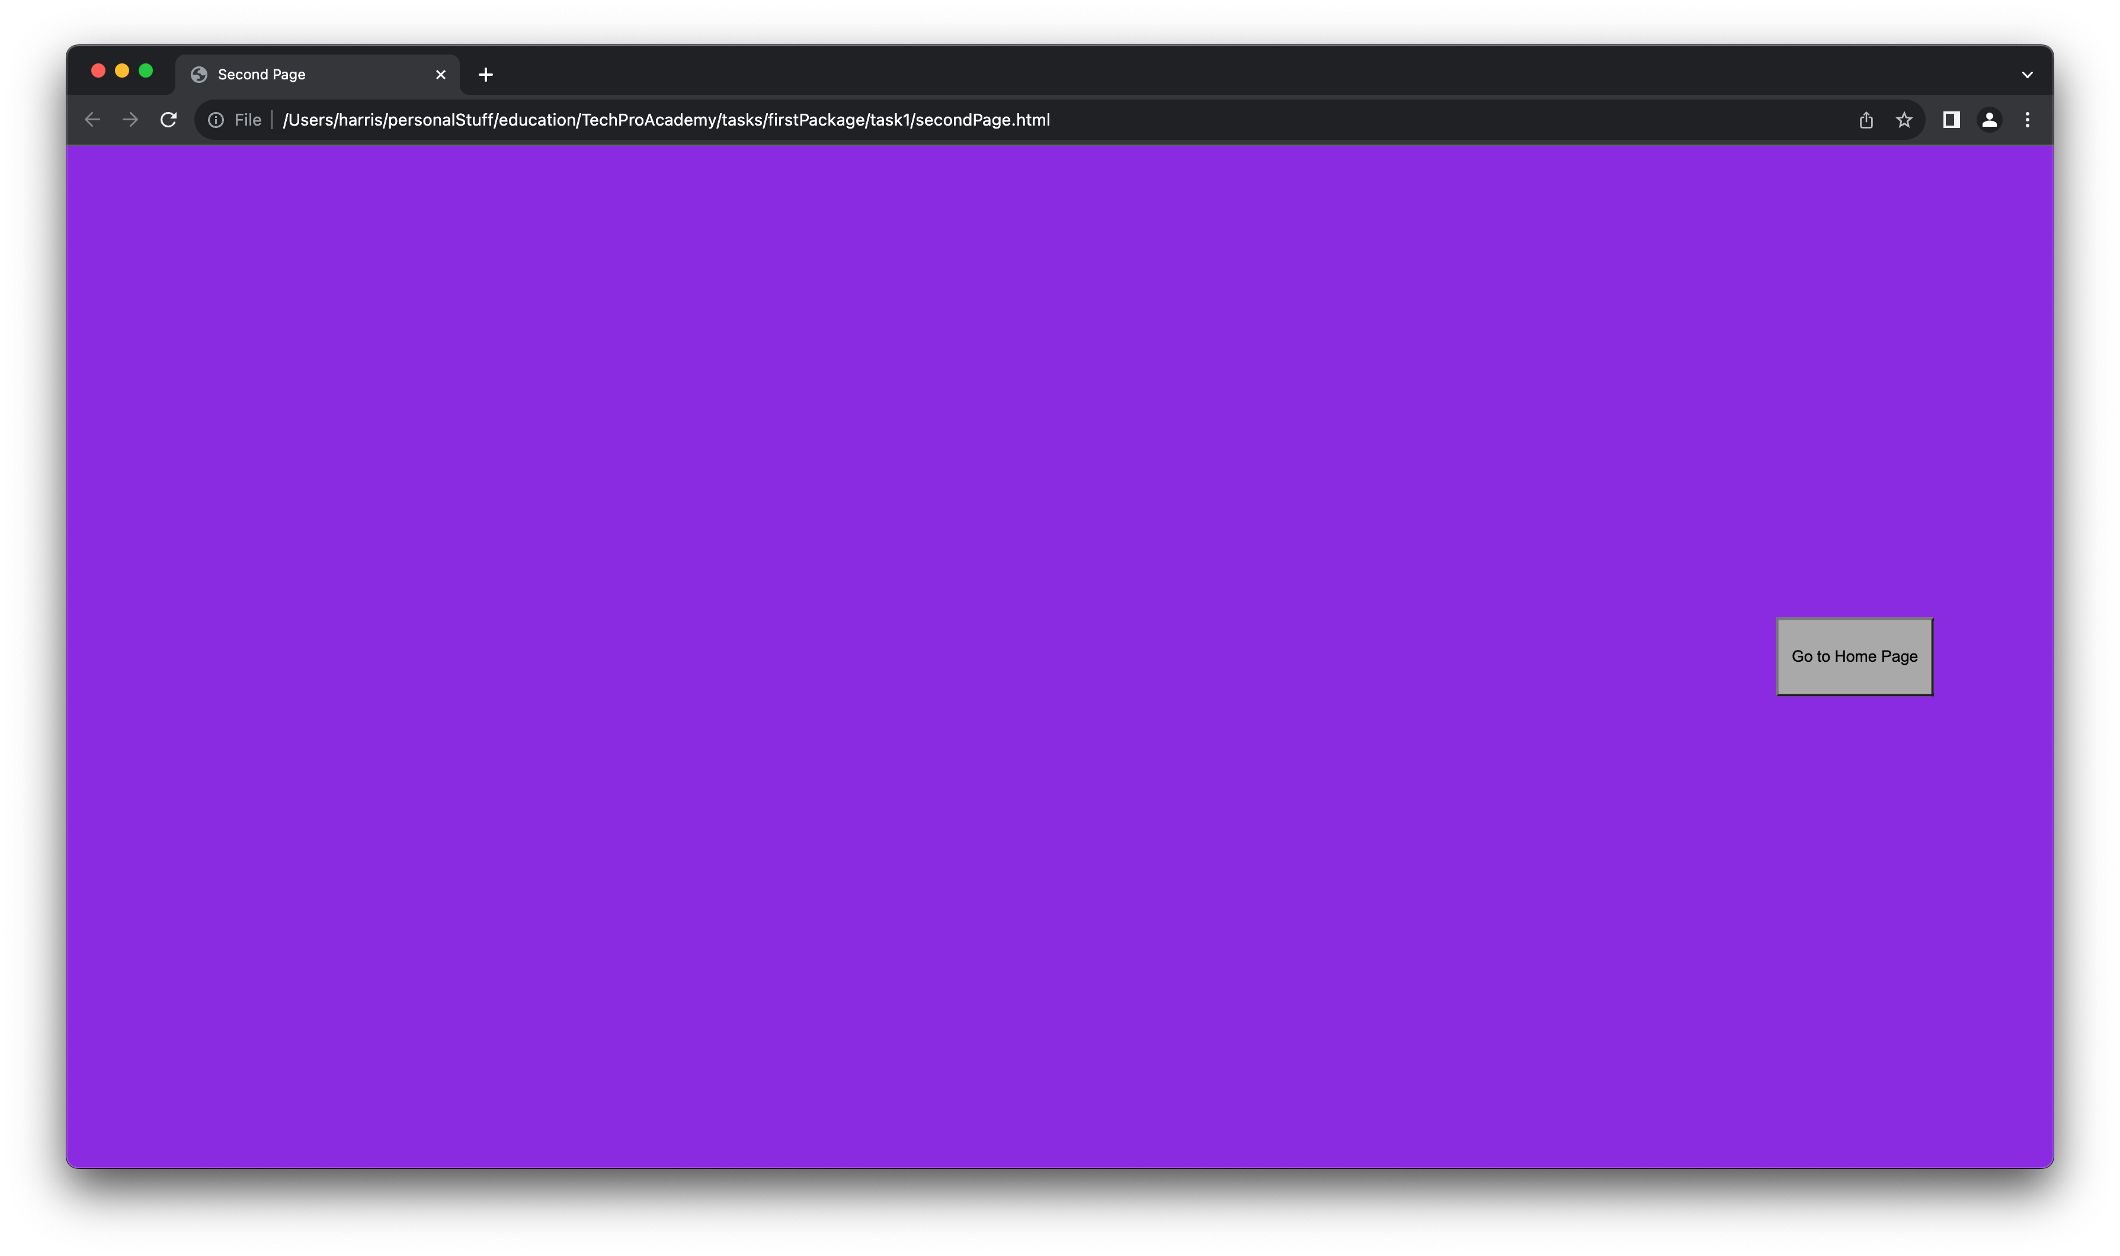
Task 1
Create a site with 2 pages.
Requirements:
The redirection between the pages will be using buttons. The buttons must be placed on the right center of the pages. It must be coloured (you choice).
Anywhere in the 1st (home) page, place your full name. The first letter of the name and the first letter of the surname must be bold.
The background color of both the pages must be coloured (your choice) but different colours.
1st page
2nd page

Slide 3
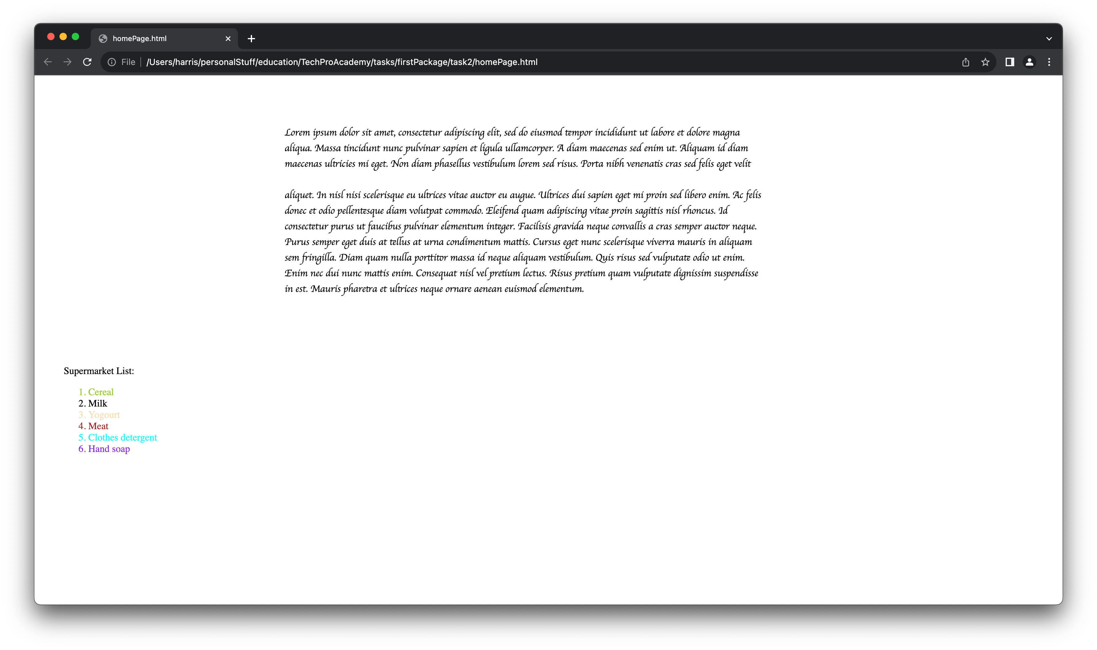
Task 2
Create a paragraph (hint: <p></p>) and write content inside (at least 10 lines).
Then between line 3 and 4 add a line break (hint: an empty tag we discussed in our lecture..).
Add a div tag below the p tag and add an ordered supermarket list (hint: we used unordered list ul, so which tag is the ordered list?) color the ordered list with color of your choice but each item a different color (hint: use span tag)

Slide 4
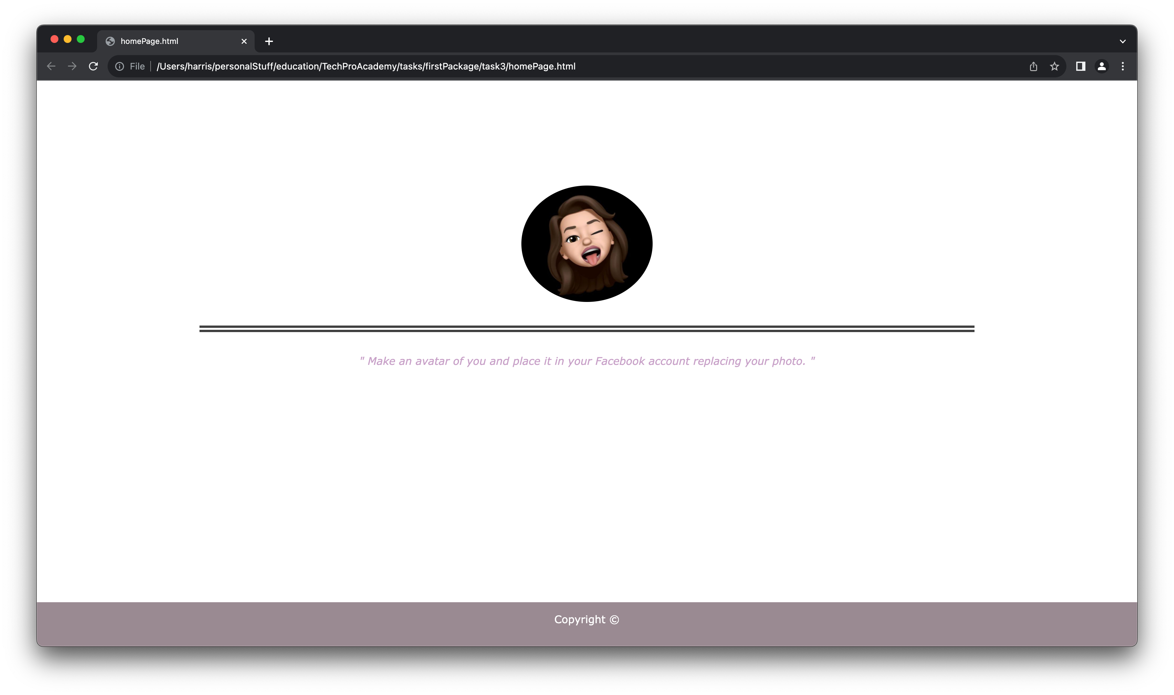
Task 3
Create a site with an image at the center. The image must be round-shaped.
Describe the image and place an hr tag anywhere inside the page.
Add a footer.

Slide 5
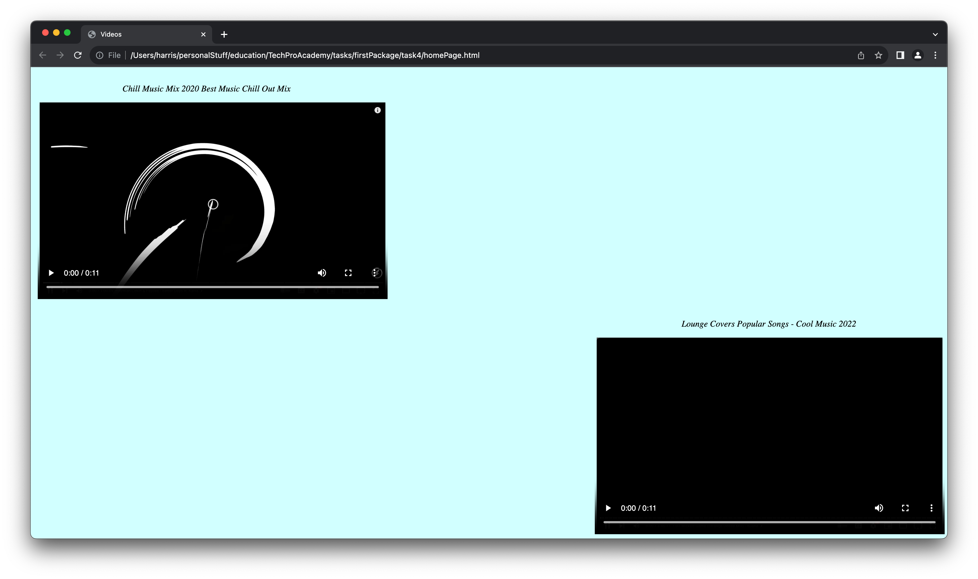
Task 4
Create a page adding 2 videos inside. One at the left and the other in a new line on the right.
Add text describing the video content.
Add a background color to the page.

Slide 6
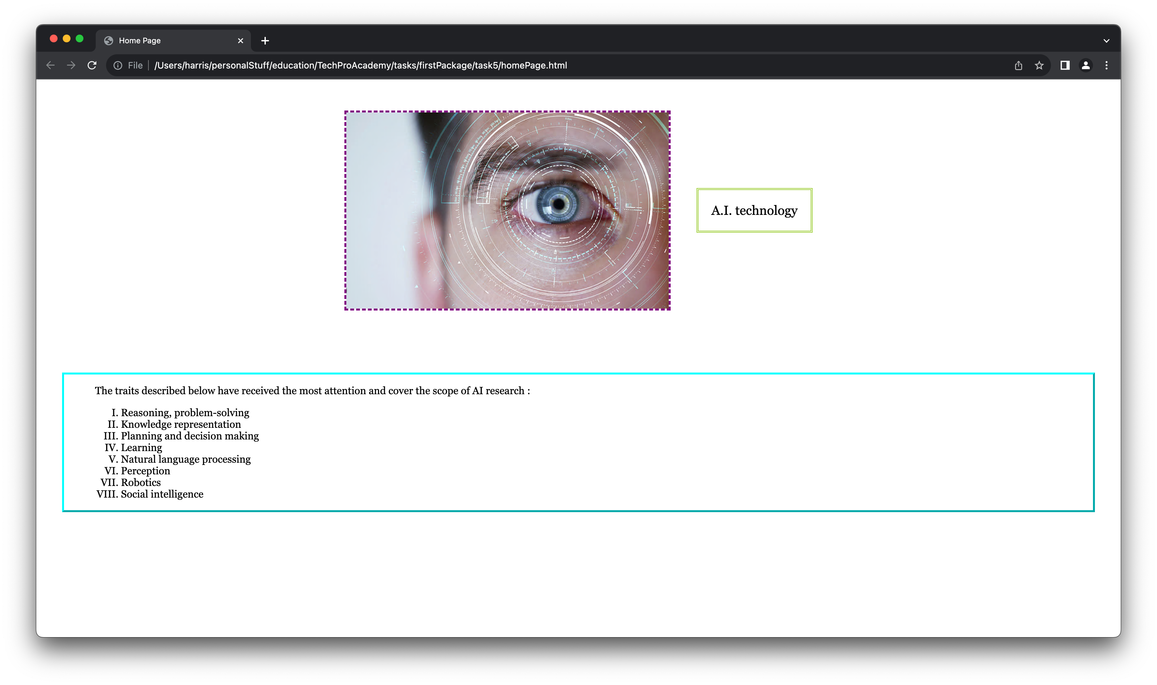
Task 5
Add a text, an image and a list inside a page.
Add borders to all your elements. Color borders(your choice) with different colors.

